Slide 1
557 Final Project: Chess Game
Matthew Gardner
Minh Truong
Tianshuang Gao
Jiale Feng

Slide 2
Introduction
IDEA: A Chess Game implemented with user interaction and animation
Concentrate on only computer graphics of the game and environment
GOAL: Produce a realistic environment where users can move chess pieces to destroy the opponent’s pieces
IMAGE

Slide 3
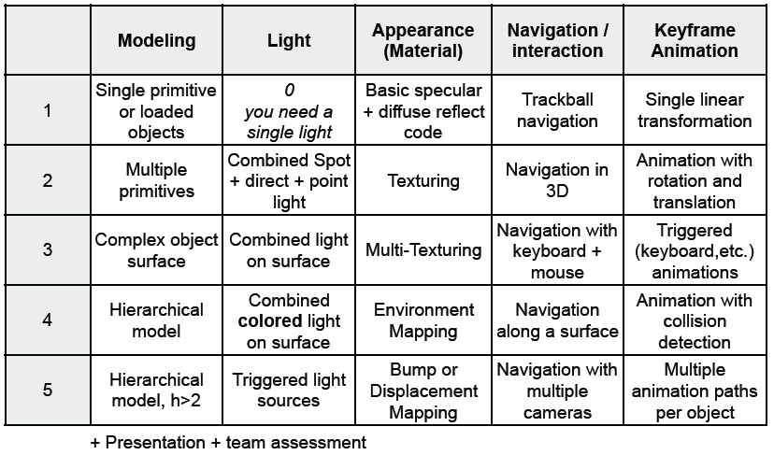

Slide 4
FEATURES
Complex Object surface
Obtain and load advanced models of all chess pieces
Combined colored light on surface
Multiple light sources to create a nice ambient scene
Displacement Mapping
Produce a unique material for chess pieces (Metal?)
Triggered Animation and rotation
Once a pieces destination is selected, animate the piece with rotation and translation

Slide 5
FEATUREs
Mouse and Keyboard navigation with collision detection
Use the keyboard to move the camera around the chess board
Select (click) a piece to move
Move the piece with the mouse while program performs collision detection
If the moving piece encounters an opponent’s piece, destroy it
If the moving piece encounters your own piece, block them from intersecting
Select the location of the moving piece as it’s destination
Animate!
Notes:
Most sophisticated technique

Slide 6
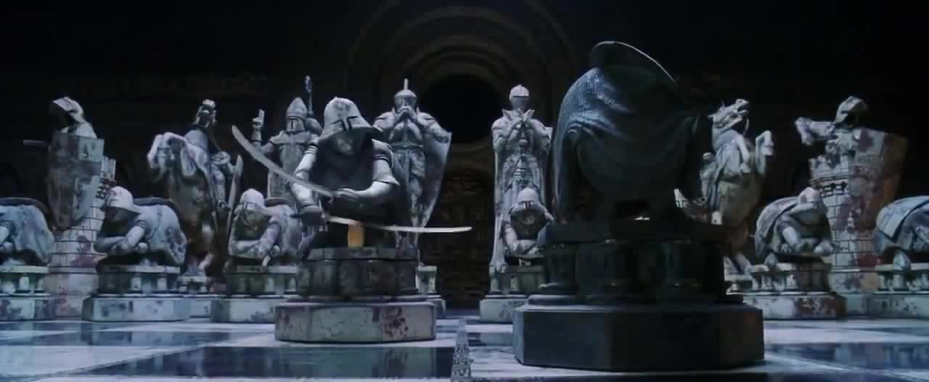
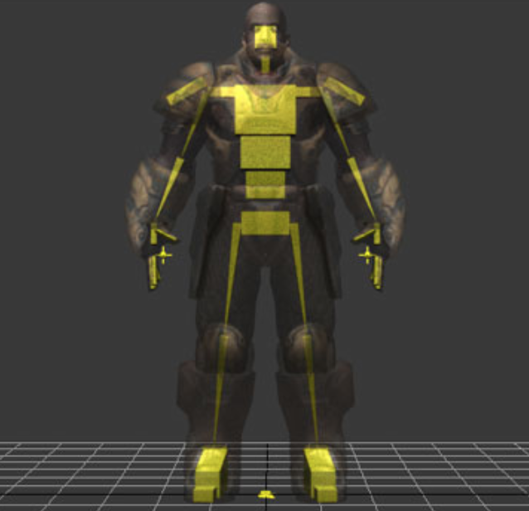
ADDITIONAL FEATURES

Slide 7

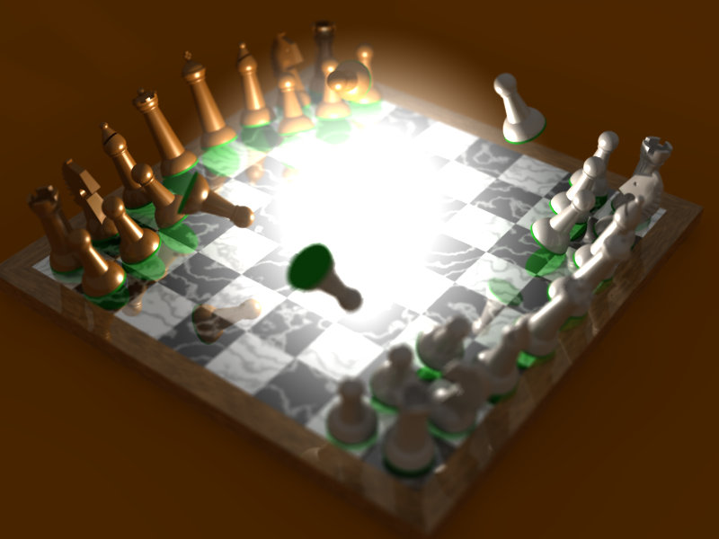
Special Effects

Slide 8
CLASSES-OBJECTS
GLObject
ChessPiece
ChessGame
PieceFactory
Get(“pawn)
Get(“knight)
ObjectIdFactory
getNewId()
convertColorToId()

Slide 9
Implementation
Factory method design pattern
Each pieces and pile in board is a separate object
Loading separate model for each pieces
Picking - Scissor cut - Object ID generation
For a number abc, the corresponding color is R: A*0.1, G: B*0.1, B: c*0.1
1-999
glfwGetMouseButton, Detect transition from press -> release

Slide 10


Slide 11
Implementation
Animate an object to a tile (Key frame animation)
Detect collision with other objects while animating (ray intersection )
Add material and lighting for the board and pieces (Texture blending and bump mapping)
Special effects (Need more research)
Current code design is designed to accommodate those improvements

Slide 12
Thank you

